Slide 1

Automatic Analysis of Audio Diary Speech Duration and Relative Volume
Connor Bechler
American Dialect Society

Slide 2
Brief Overview
Motivating Problem(s)
Current Project
Evaluating the Methods
Discussion (and Demo if time/interest)

Slide 3
Broad Problem
Dialectologists and sociolinguists work with messy naturalistic data, and increasingly work with large amounts of it
Archives, oral history projects, undergraduate data collection, remote online recordings, Zoom interviews
This audio data varies widely in quality, due to variation in…
Recording technology
Individual Speech volume
Archival integrity
Issues with digital transfer and conversion of files
As a result, it can be a challenge to assess how much usable speech data is present in a corpus

Slide 4
Case Study – MI Diaries Project
Ongoing longitudinal sociolinguistic project started in 2019 (Sneller et al., 2022)
Diarists record and submit audio through a mobile app
Answering prompts designed to elicit personal narratives
Diary audio quality varies dramatically across recordings, due to…
Movement during recording
Different kinds of phones
Noisy settings
Microphone muting
Notes:
Regardless of the size of the research project, the same problem arises if the quantity of data is much greater than the

Slide 5
Case Study – MI Diaries Project
Roughly 30-40 diaries of 10-15 minutes each submitted every week
Diaries are reviewed for three main purposes by specific teams:
Featuring stories on the project website
Compensating diarists who record >15 min of audio a week
This process is already partially automated, but relies on total audio submitted rather than total speech
Transcribing/correcting diaries to build datasets to answer specific research questions
Each of these processes is necessarily time consuming
Streamlining the process frees up time for other tasks

Slide 6
Given an arbitrarily large corpus, is it possible to…
(b) automate the identification of problematic* recordings?
(a) summarize speech quantity and quality for each recording?
*For analysis

Slide 7
But What Exactly is an “Acceptable” Recording?
Speech should be separable from background noise to enable…
Qualitative analysis/understanding of the content of the speech
Quantitative (acoustic and/phonetic) analysis of the speech
Speech should constitute most of the recording, because this…
Provides more data for analysis
Enables screening for participants submitting mostly non-speech
Allows identification of gaps in corpus, issues with audio files or recording equipment, etc.

Slide 8
Existing Approaches
ELAN (Wittenberg et al., 2006)
Provides duration statistics for annotations
Generates annotation density plots
Offers interface for using silence detection to segment audio
However, only works on one file at a time, and silence detection doesn’t account for noise
PRAAT (Boersma & Weenink, 2024)
Performs silence detection and voice activity detection for segmentation
Offers indirect means of calculating tier durations
Can calculate duration for corpus, but requires scripting

Slide 9
Desired (Semi-Automatic) Solution
Key Features
Secondary Features
Automatic calculation of speech quality and quantity for a given audio file
… and a summary for a group of files
Flagging of audio files that are deemed problematic
Fast enough to operate on large audio files and corpora of many files
Lightweight code/few dependencies
… so it is easy to integrate into existing MI Diaries Research Framework
Easy to use/has optional graphical user interface
… so it is useful for other projects

Slide 10
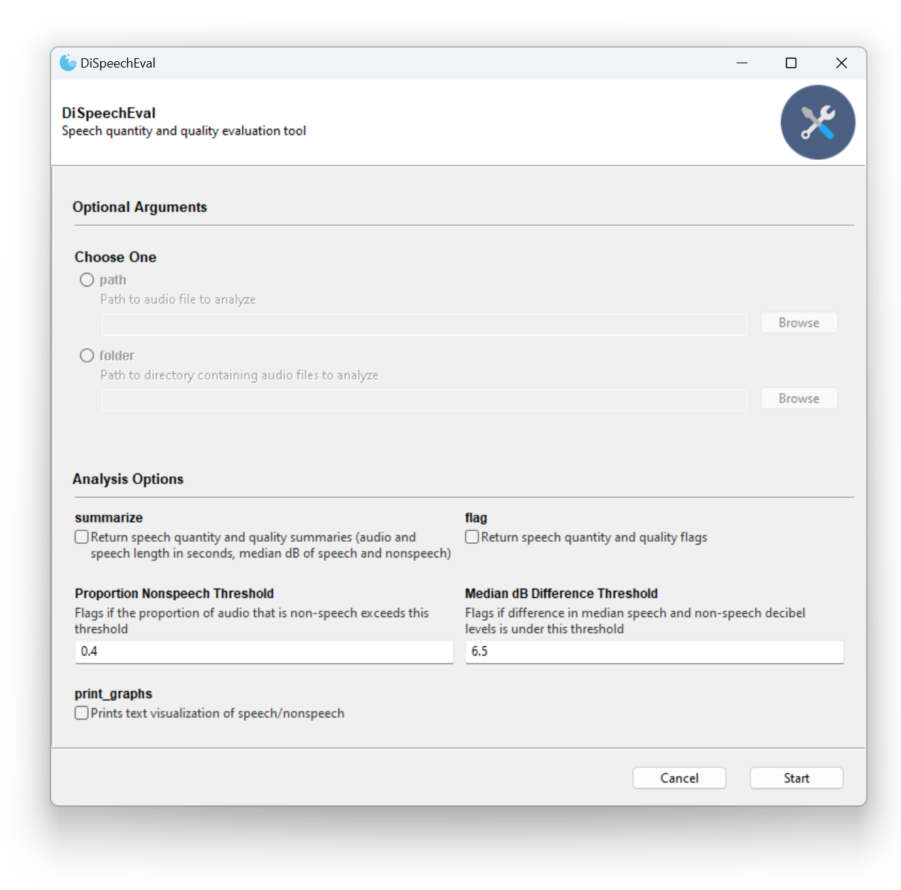
Current Project
Developed a publicly available Python program, called DiSpeechEval
Lightweight code with command line and graphical user interfaces
Output is the same between the terminal and GUI

Slide 11
Method - Calculating Speech Quantity
Used rVAD Voice Activity Detection (Tan et al., 2020) to segment audio into speech/non-speech
Approach takes both pitch and energy into account to exclude high energy noise
Widely used and relatively fast
Calculates total quantity of speech and proportion of speech to non-speech
Also provides simple visualization of speech distribution in recording
In the future, will also export speech segments to Praat TextGrids or ELAN EAFs

Slide 12
Method - Quantifying Speech Quality
Tested several standard sound quality metrics
Loudness, sharpness, roughness, speech intelligibility (Green Forge Coop, 2020)
However, these were computationally expensive, not feasible for large quantities of audio
Instead, tried to capture speech separability from background noise via decibel measurements
Uses librosa (McFee et al., 2015) to take median decibel measurements of speech versus nonspeech
Then takes the difference between the two decibel levels
Faster and simpler to calculate than other sound quality metrics
However, as this metric was produced ad hoc, it requires further validation

Slide 13
Problematic Audio Identification
Testing this by trying to find thresholds for each metric that consistently separate low-quality audio files from acceptable quality audio files
This requires:
Creating training and testing sets of audio files
Calculating quantity and quality metrics per file in the training set
Finding quantity and quality thresholds for accurately* separating low-quality audio from acceptable quality audio files
Applying those thresholds to the testing set
Calculating the number of correctly flagged, incorrectly flagged, and unflagged files that result
If no such thresholds exist, one or both metrics are flawed
Can the two metrics be used to effectively flag problematic audio?

Slide 14



Accuracy Metrics
Precision
What proportion of flagged items are incorrectly flagged as low-quality?
Recall
What proportion of low- quality items are correctly flagged as low quality?
F1
Harmonic mean of precision and recall
$$precision= \frac{tp}{tp+fp}$$
$$recall= \frac{tp}{tp+fn}$$
$$F1= \frac{2tp}{2tp+fp+fn}$$
What kind of accuracy should we prioritize?
Casting a wide net – prioritizing false positives over false negatives
More useful for workflow maximizing data or using audio enhancement on low-quality audio
Balanced approach – weighing false negatives and false positives equally
Screening narrowly – prioritizing false negatives over false positives
More useful for conservative workflow in which screened audio will not receive immediate review (MI Diaries case)

Slide 15
Creating Training and Testing Sets
Training Set
12 recordings selected to be featured on website (acceptable audio quality)
11 recordings noted by team members as noisy or containing long silences (low quality)
Testing Set
Random sample of 10 recordings over five minutes long from each diarist age group (kids, teens, adults)
Impressionistically coded each recording as acceptable or low audio quality, and if this was primarily due to prolonged silences or background noise
Set | Training |  | Testing
Sub-Set | Acceptable | Low | Kid | Teen | Adult
Duration (Min.) | 165 | 206 | 123 | 121 | 221
% Low Qual. | 0% | 100% | 40% | 40% | 0%
Notes:
Kid = 7406.61 ┆ 4793.72
Teen = 7279.72 ┆ 5273.76
Adult = 13265.8 ┆ 10496.22

Slide 16
Evaluation Results
So, can the two metrics (speech quantity, speech versus nonspeech median decibel level) be used to effectively flag problematic audio?
… speech quantity yes, but median decibel difference probably not (at least not for Diaries data)
even with an extremely low threshold for decibel difference, it still results in false positives
Approach | Ratio of Speech to Nonspeech | Difference in Median dB | Precision | Recall | F1
Wide | 0.40 | 6.5 | 0.38 | 1.00 | 0.55
Balanced | 0.40 | 3.5 | 0.53 | 0.78 | 0.64
Narrow | 0.40 | 2.3 | 0.86 | 0.67 | 0.75

Slide 17
Discussion and Future Directions
Calibration of the speech quality metric for the flagging task still requires work
Possible that my training set selection could be better curated
Also possible that median decibel level difference is simply not informative about speech separability
Hoping to add in additional audio quality metrics and better visualizations
Maybe taking the number of speech segments with median or average dB levels below the median dB level of nonspeech segments?
If you have any suggestions, please let me know!
If there are any other features that would be useful to your work, please ask!

Slide 18

Gratitude and Questions
Thank you all for your time and attention!
Thanks to Betsy Sneller, Suzanne Wagner, the MSU Sociolinguistics Lab, and the entire MI Diaries Team!
I welcome and appreciate any and all questions and feedback!

Slide 19
References
Boersma, P., & Weenink, D. (2024). Praat: Doing phonetics by computer (Version 6.4.13) [Computer software]. http://www.praat.org/
Coop, G. F. (2024). MOSQITO (Version v1.1.1) [Computer software]. Zenodo. https://doi.org/10.5281/zenodo.10629475
McFee, B., Raffel, C., Liang, D., Ellis, D. P., McVicar, M., Battenberg, E., & Nieto, O. (2015). librosa: Audio and music signal analysis in python. SciPy, 18–24.
Sneller, B., Wagner, S. E., & Ye, Y. (2022). MI Diaries: Ethical and practical challenges. Linguistics Vanguard, 8(s3), 307–319.
Wittenburg, P., Brugman, H., Russel, A., Klassmann, A., & Sloetjes, H. (2006). ELAN: A professional framework for multimodality research. 5th International Conference on Language Resources and Evaluation (LREC 2006), 1556–1559.

Slide 20
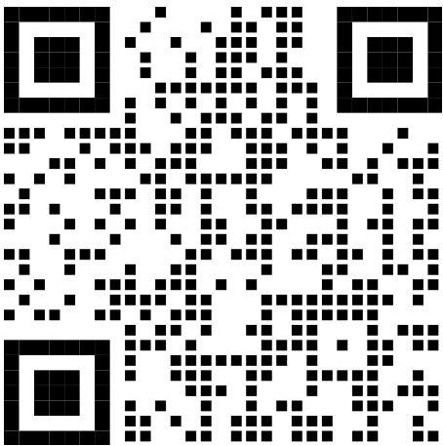
Demo and Link
https://github.com/ConnorBechler/dispeecheval

